Slide 1



E-Commerce Sales Dashboard Analysis
A Comprehensive Overview of Techniques and Tools
Date: 27 April 2025
Name: Prerana V
Start Slide

Slide 2


OBJECTIVE
Creating an interactive dashboard for business stakeholders.
Visualize and analyze Sales, Profit, and other KPIs.
To provide business insights to support data-driven decisions.

Slide 3


Dashboard Overview
This dashboard visualizes e-commerce sales data across categories, regions, and segments.
Key metrics include Sales, Profit, Orders, Profit Margin, Average Order Value, and Average Shipping Days.
Interactive filters allow analysis by Category and Region.

Slide 4

Key Metrics
Key Performance Indicators (KPI’s)
Total Sales: $2.30M
Total Profit: $286.40K
Profit Margin: 12.47%
Total Orders: 5009
Average Order Value: $458.61
Average Shipping Days: 3.96

Slide 5

Dashboard Features
Time Series Analysis: Monthly Sales & Profit trends.
Slicers/Filters: By Category, Region.
Cards: KPIs for quick summary.
Pie/Bar Charts: Segment-wise, Regional Sales distribution.
Consistent Color Theme: Professional and clean layout.
Navigation Simplicity: Easy to explore key metrics.

Slide 6

Sales and Profit Trends ( by Month )
Sales and profits have seasonal patterns, peaking towards the end of the year (November, December).
2017 shows the highest monthly performance compared to earlier years.
Dip in mid-year (May–August), followed by strong year-end recovery.

Slide 7


Sales by Category &
Sub-Category
Category wise
Sub- Category wise
Top Category: Office Supplies ($6.0K sales)
Furniture and Technology categories show lower sales compared to Office Supplies.
Focus on boosting sales for underperforming categories.
Phones and Chairs are the best-selling sub-categories (~$0.33M each).
Storage follows with $0.22M sales.
Consider inventory and promotion focus on best-selling sub-categories.

Slide 8



Sales by Shipping Mode
Majority of orders are through Standard Class.
Second Class and First Class have significant but lesser contributions.
Same Day shipping is minimal — opportunity to promote faster delivery options.

Slide 9
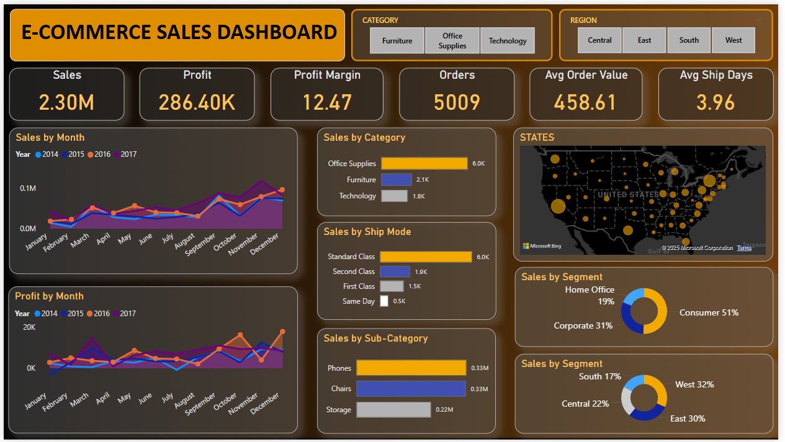

Slide 10


Key Business Insights
Strong year-end sales boost (Nov-Dec).
Consumer segment leads revenue (51% share).
West and East regions dominate sales.
Phones and Chairs are the highest-selling sub-categories.
Opportunity to grow sales in Central and South regions.
Potential to promote Same-Day Delivery for competitive advantage.

Slide 11
Conclusion
Overall healthy growth in sales and profits, especially towards year-end.
Focus on expanding sales in Central and South regions.
Promote faster shipping options (Same Day).
Target corporate and home office customers with tailored promotions.
Optimize inventory based on top-performing categories and sub-categories.

Slide 12

Thank You
FOR YOUR ATTENTION
See You Next

